Slide 1
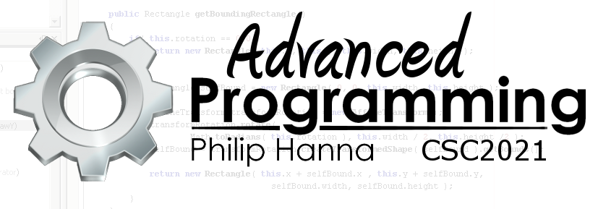
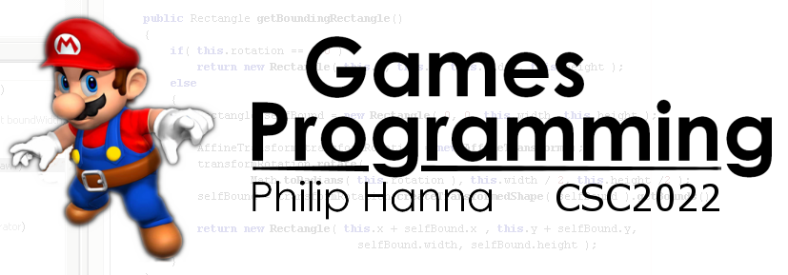
Game AI
Introduction to the role of Artificial Intelligence within games.

Slide 2

Introduction to Game AI

Slide 3
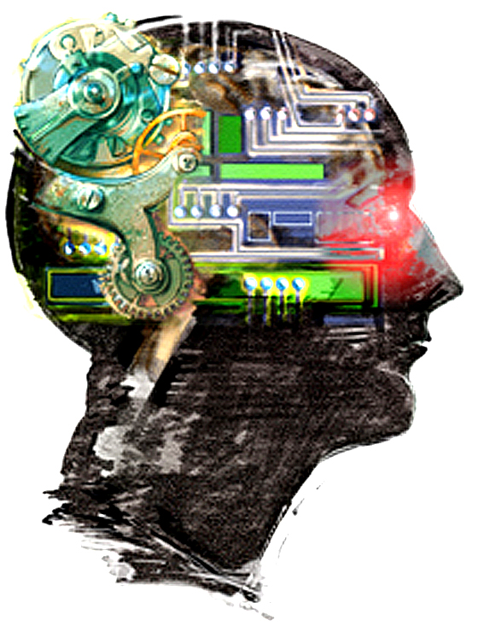
: Academic vs. Game AI
Artificial intelligence aims to develop machines that can perform human ‘thinking’ tasks.
Academic research is split into two camps:
Strong AI – creating systems that model human thought processes.
Weak AI – creating working systems that need not be physiologically plausible.
Academic AI tends to focus on optimal problem solving.
Game AI must work within tight computational constraints, i.e. effort vs. outcome is key.

Slide 4

: The Aims of Game AI
A game-oriented AI must:
appear intelligent, yet purposely flawed (i.e. beatable)
have no unintended weaknesses (that can be repeatable exploited)
provide an entertaining or engaging experience
perform within tight CPU/memory constraints
be configurable
not keep the game from shipping

Slide 5
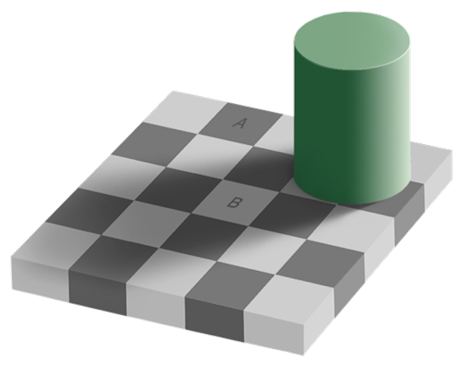
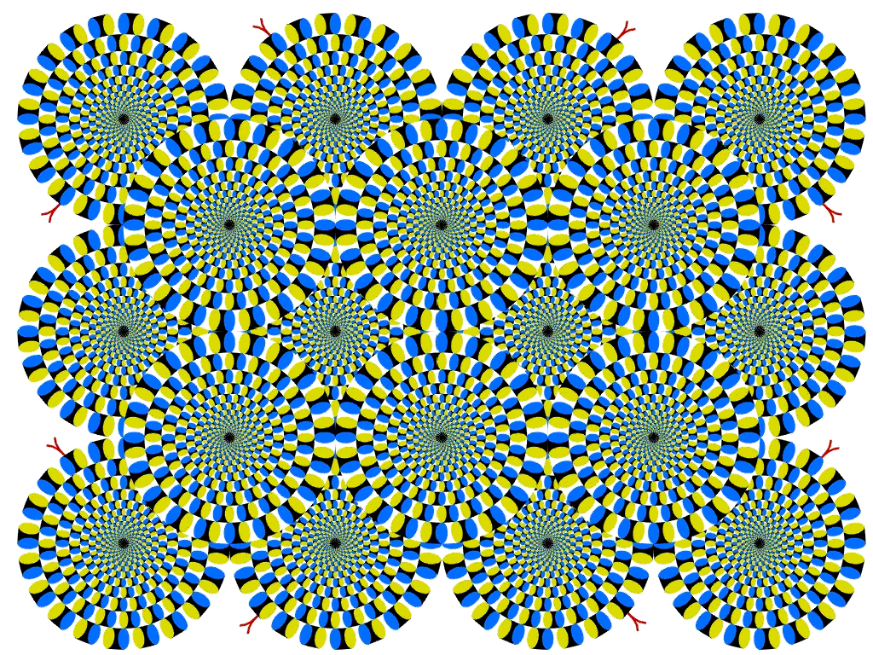
: The Illusion of Intelligence
Most people assess intelligence (or the lack thereof) on how an object behaves.
Acting in a complex (human-like) manner is readily perceived as intelligence behaviour.
Often simple or semi-random behaviour will be interpreted by the player as complex and intelligent.
Aside: A and B are the same colour. We perceive them as different colours.
Notes:
A common means of enhancing game AI is to provide visual/auditory feedback on what the game object is ‘thinking.’

Slide 6

A Practical Definition of Game AI
“Game AI is anything that contributes to the perceived intelligence of an entity, regardless of what’s under the hood.”

Slide 7
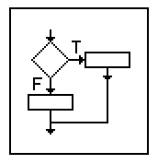

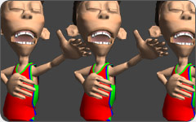


: Game AI, or Not…
Which of the following could be classified as providing an example of AI within the context of a game?
Does a single ‘if’ statement constitute intelligence?
What about scripted behaviour?
If an NPC selects which animation to play? (If this is done via a set of if statements?)
Maybe path-finding?
If the game automatically generates an environment?

Slide 8
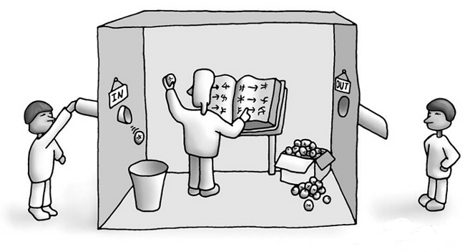
: Searle’s Chinese Room Argument
Aside: Consider Searle’s Chinese Room argument. Could a game AI ever possess self-awareness? What would be the implications if it could?

Slide 9

AI Engines

Slide 10
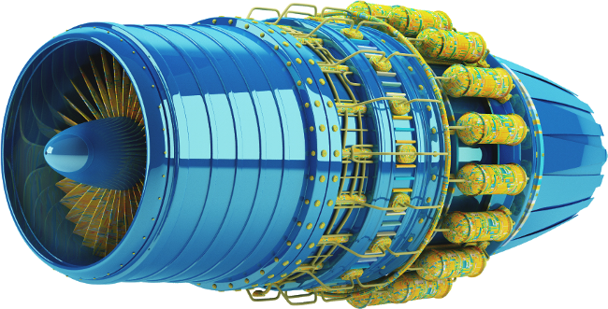
In simple games, AI tends to be bespoke and individually written for each character (e.g. in the layer/object update).
In more complex games there is often a set of general AI routines that can be controlled by level designers, etc.
Aside: Unless you explicitly wish to do so, you do not need to define a separate AI engine in your relatively simple game.

Slide 11
: Illustrative Structure
Execution Management
Higher-level AI applies to groups, whilst lower-level AI operates on individual game objects.
The AI gets some time to perform / progress its routines.
The AI engine can query the world to obtain information.
The output of the AI engine is turned into actions that update the game state.
Movement (Character AI)
Decision Making (Char AI)
Strategy (Group AI)
AI obtains world information
World Interface
AI output is turned into action
Animation
Physics
...

Slide 12
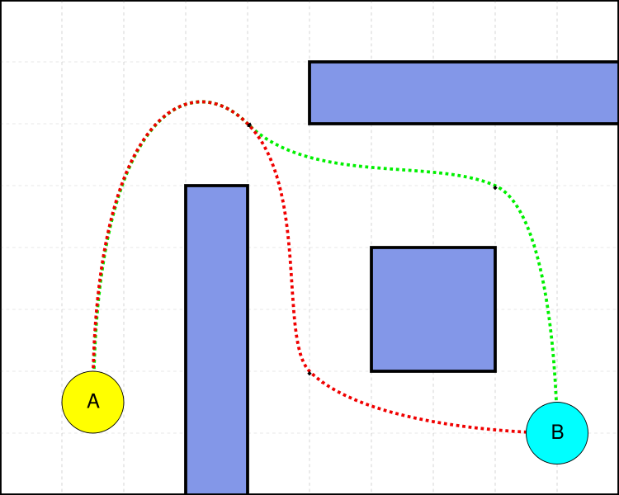
: Movement
Execution Management
The movement component contains a range of algorithms that make decisions about motion.
There are a range of movement algorithms, from very simple, to very complex.
Movement (Character AI)
Decision Making (Char AI)
Strategy (Group AI)
World Interface
Animation
Physics
...

Slide 13

: Decision Making
Execution Management
Game characters can have a number of different behaviours that can be performed. A decision making process can determine which behaviour is best at a given point in time.
Movement (Character AI)
Decision Making (Char AI)
Strategy (Group AI)
World Interface
Selected behaviours are then translated into action (possibly making use of movement AI, or simply triggering a action, e.g. an animation).
Animation
Physics
...

Slide 14

: Strategy
Execution Management
In order to coordinate the behaviour of multiple game objects some form of strategic AI is needed.
Strategic AI controls/ influences the behaviour of a group of characters, often devolving the execution of the group behaviour to individual decision making / movement algorithms.
Movement (Character AI)
Decision Making (Char AI)
Strategy (Group AI)
World Interface
Animation
Physics
...

Slide 15
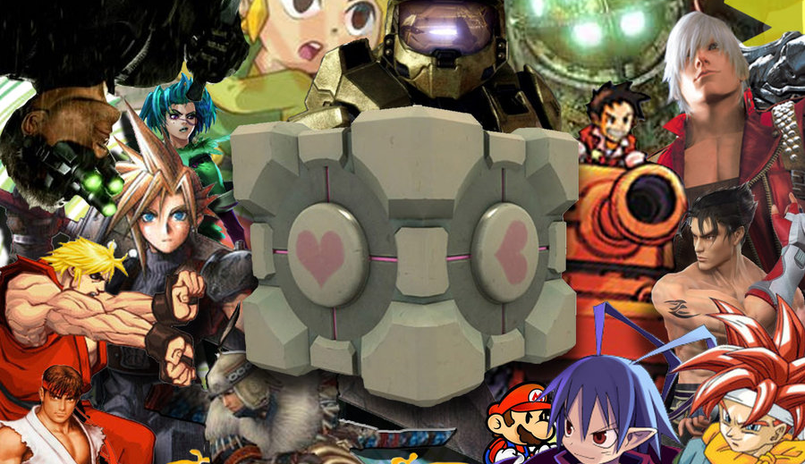
Typical 2D Genre AI

Slide 16
AI needs within the game can include:
Perception – determining what can be seen by the entity
Steering – basic character movement
Action – executing available actions, e.g. aiming, etc.
Path-finding –route planning
Decision making – determining what to do next (dodge, seek etc.). At higher levels this becomes tactical AI.
Perception
Strategic AI
Steering
Decision Making
State Change
Line of sight tests
Influence maps
Kinematic movement
FSM
Object update

Slide 17
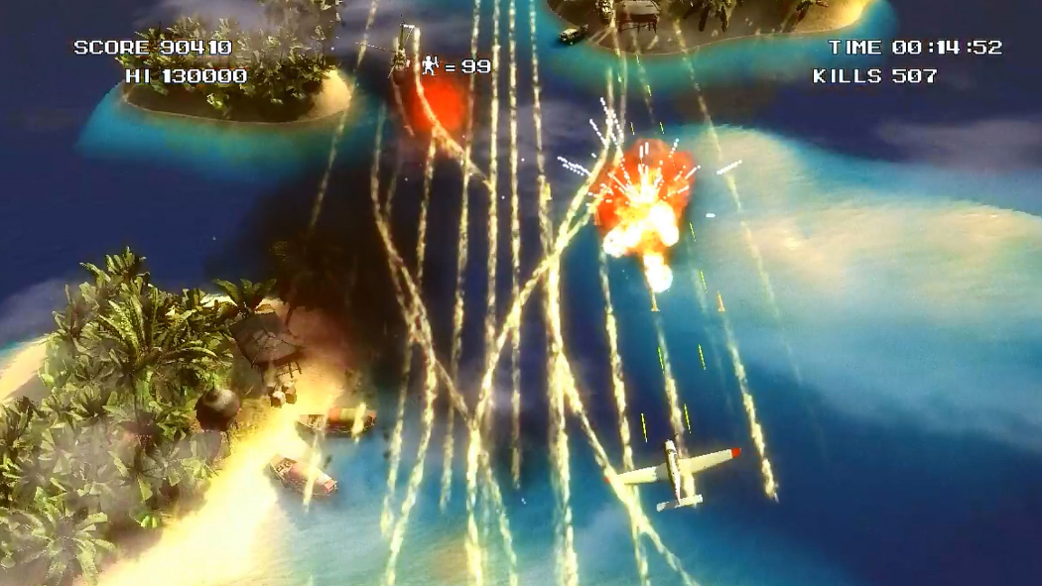
Side-on/Top-Down Shooters
Perception – detecting nearby objects, incoming projectiles, etc.
Steering – opponent movement, e.g. player tracking, projectile avoidance, etc.
Firing – basic control, firing towards player
Perception
Shooting
Steering
State Change
Object detection
Path follow, Evade
Path projection
Object update
Aside: Some games rely on fixed patterns of movement and enemy numbers to provide challenge

Slide 18
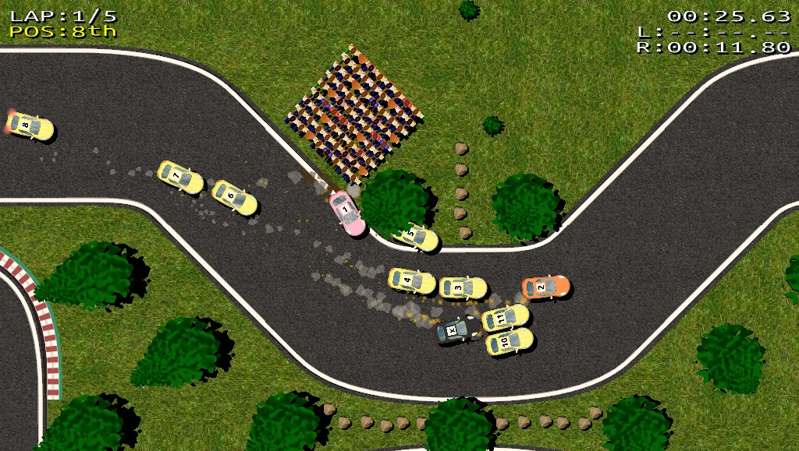
Driving Games
Perception – detecting other traffic
Steering – driving line, cornering, breaking
Decision making – overtaking points, collision avoidance
Perception
Steering
Decision
Making
State Change
Predictive collision detection
FSM, Rule-based system
Path following
Object update

Slide 19
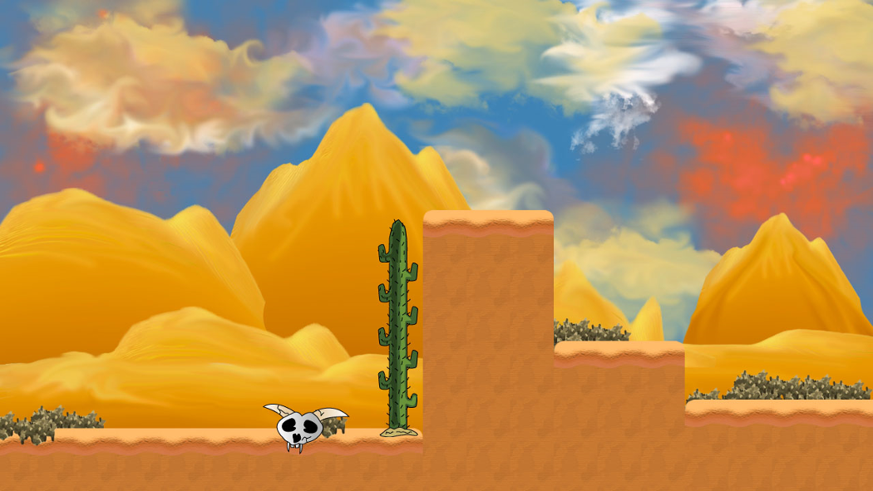
Perception
Shooting
Steering
State Change
Platform Games
Perception – determining actions/movement of player
Steering – moving towards/away from player
Shooting – basic control, aiming
Player proximity
Path follow, Pursue
Player proximity trigger
Object update
Aside: Platform games tend to have opponents with predictable and easily understood behaviour. Challenge arises from the need to time jumps, shots, etc.

Slide 20
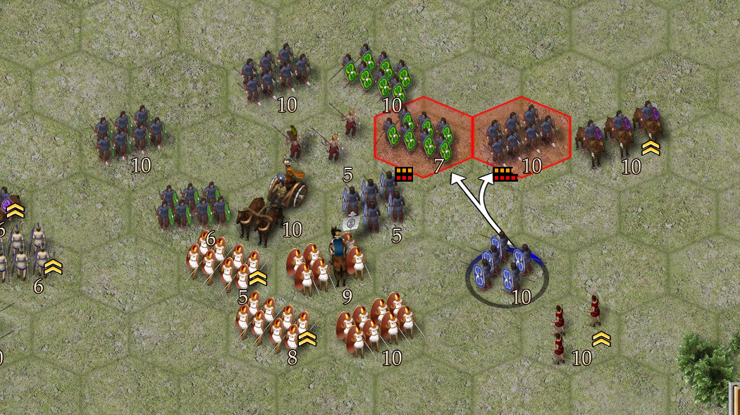
Real-time/Turn-based Strategy Games
Perception – determining what can be seen (other opponents, items)
Steering – group movement, etc.
Path-finding – route planning
Tactical and Strategic Analysis – determining overall strategy build, attack, etc.
Perception
Strategic AI
Path finding
/ Steering
Tactical AI
Decision Making
State Change
Opponent visibility, Fog-of-war
Tactical analysis, Influence maps
Map/local path-finding
Rule-based system/ FSM
Object update
Aside: AI in real-time games is mostly the same as in turn-based games. Real-time games must impose tight performance constraints on the AI.

Slide 21
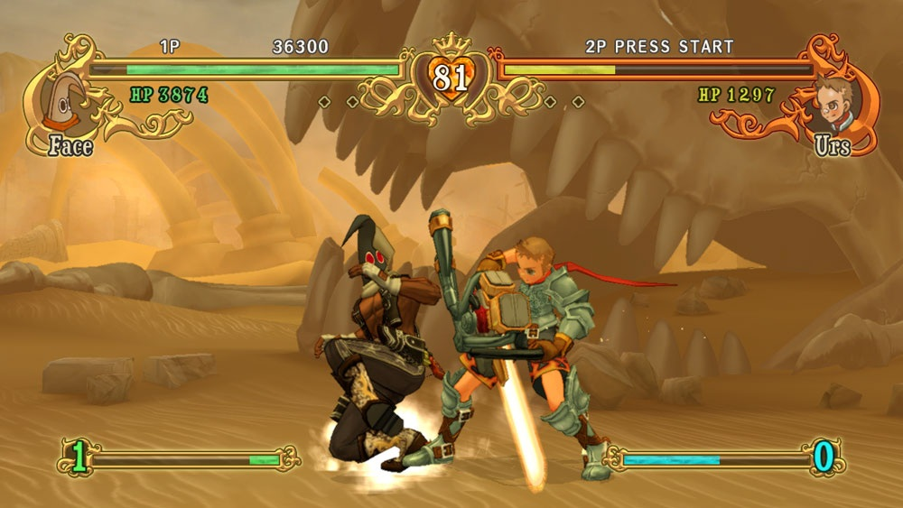
Beat-em-up Games
Decision making – determining what to do next (block, back-up, attack, etc.).
Decision Making
State Change
FSM / Rule-based behaviour
Object update
Aside: The behaviour can be adaptive, i.e. reacting to the player’s patterns of behaviour

Slide 22
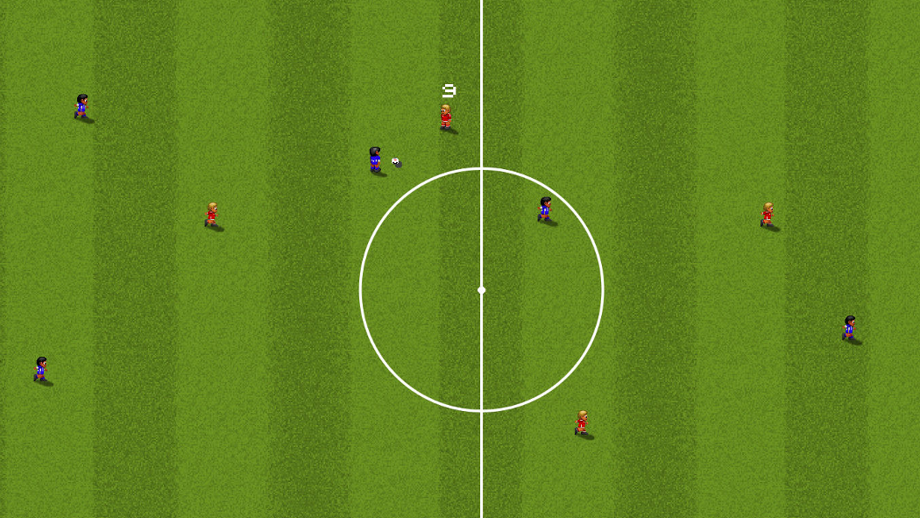
Sports Games
Steering – basic character movement, group movement, etc.
Decision making – determining what to do next, selecting plays, formations, etc. from an available ‘playbook’
Tactical Analysis – determining play objectives
Tactical AI
Steering
Decision
Making
State Change
Influence Maps
Rule-based system
Chase, Evade, etc.
Object update
Aside: Sport AI can draw upon existing expert knowledge, but must return realistic, ‘human-like’ behaviour

Slide 23

Key takeaways:
AI is a broad area of study within Computer Science. It is used within games to bring game entities ‘to life’.

